Slide 1
Debugging

Slide 2
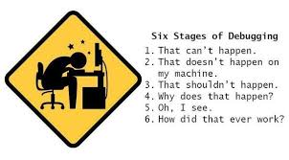
Debugging - Introduction

Slide 3
How can it make you a better developer?
Realize the nature of bugs
Fixing bugs is how we learn
We get better at learning things
Experience is definitely required
Try things first
Use Google as a last resort

Slide 4
What is a debugger?
A debugger is a program that simulates/runs another program and allows you to:
Pause and continue its execution
Set “breakpoints” or conditions where the execution pauses so you can look at its state
View and “watch” variable values
Step through the program line-by-line

Slide 5
Stepping
Stepping is a debugger feature that lets you execute (step through) your code line by line. This allows you to examine each line of code in isolation to determine whether it is behaving as intended.
There are actually 3 different stepping commands:
step into
step over and
step out
A breakpoint is a special marker that tells the debugger to stop execution of the program at that point, when running in debug mode.

Slide 6
Debugging Tips
Examine the most recent change
Debug it now, not later
Read before typing
Make the bug reproducible
Display output to localize your search
Write a log file
Use tools
Keep records

Slide 7


IDE
What is an IDE?
An integrated development environment (IDE) is a software
suite that consolidates basic tools required to write and test software.
IDE’s that are best suited for code management, highlighting, debugging facilities include -
QTCreator
Kdevelop
Eclipse
There are many others too

Slide 8
Features of IDE
An IDE typically contains a code editor, a compiler or interpreter, and a debugger, accessed through a single graphical user interface (GUI).
The user writes and edits source code in the code editor.
The compiler translates the source code into a readable language that is executable for a computer.
And the debugger tests the software to solve any issues or bugs.

Slide 9
Java Errors/Exceptions
The most commonly resolvable exceptions in Java through debugging -
NullPointerException
IndexOutOfBoundsException
ClassCastException
Arithmetic Exception
NumberFormatException
StackOverflowException

Slide 10
Debugging Java in Eclipse
Eclipse is an integrated development environment (IDE) for Java and other programming languages like C, C++, PHP, and Ruby etc.
Java developers typically use Eclipse Classic or Eclipse IDE for developing Java-based applications.
Understanding these primary concepts wrt Eclipse environment is important
Workspace
Project Creation
Perspective
Views

Slide 11
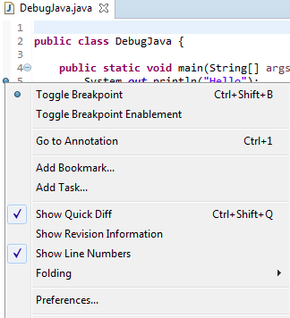
Debugging Java in Eclipse
1. Breakpoints
To define a breakpoint in your source code, right-click in the left margin in the Java editor and select Toggle Breakpoint. Alternatively, you can double-click on this position

Slide 12
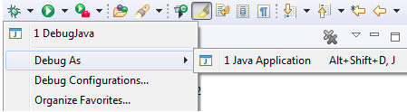
Debugging Java in Eclipse
2. Launching and Debugging a Java program
A Java program can be debugged simply by right clicking on the Java editor class file from Package explorer. Select Debug As → Java Application or use the shortcut Alt + Shift + D, J instead.

Slide 13
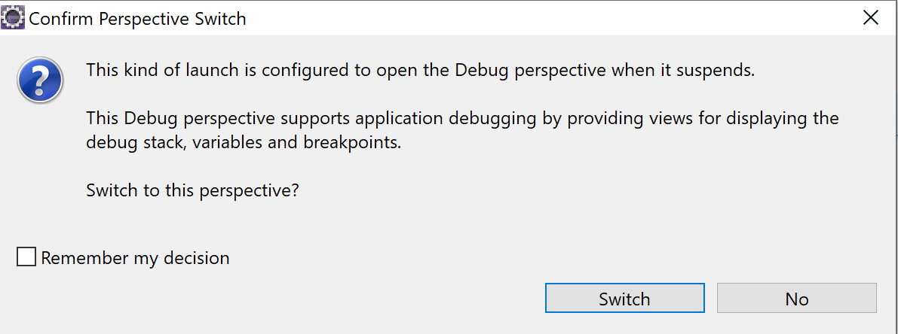
Debugging Java in Eclipse
3. Debug Perspective
When a Java program is started in the debug mode, users are prompted to switch to the debug perspective.

Slide 14
Debugging Java in Eclipse
Debug view – Visualizes call stack and provides operations on that.
Breakpoints view – Shows all the breakpoints.
Variables/Expression view – Shows the declared variables and their values. Press Ctrl+Shift+d or Ctrl+Shift+i on a selected variable or expression to show its value. You can also add a permanent watch on an expression/variable that will then be shown in the Expressions view when debugging is on.
Display view – Allows to Inspect the value of a variable, expression or selected text during debugging.
Console view – Program output is shown here.

Slide 15
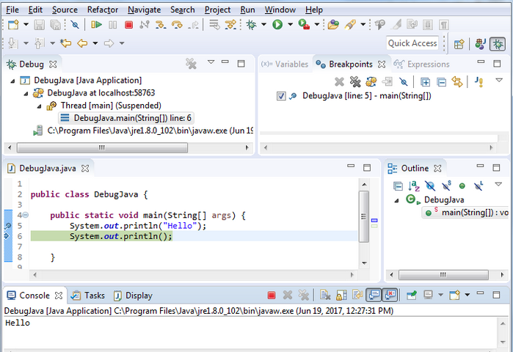
Debugging Java in Eclipse

Slide 16
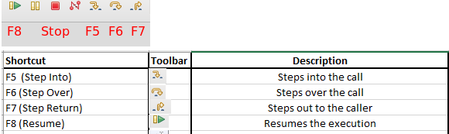
Debugging Java in Eclipse
4. Stepping commands
The Eclipse Platform helps developers debug by providing buttons in the toolbar and key binding shortcuts to control program execution.

Slide 17
Debugging - Conclusion
Debugging steps and commands can be found in detail @
https://help.eclipse.org/neon/index.jsp?topic=%2Forg.eclipse.jdt.doc.user%2Ftasks%2Ftask-stepping.htm

Slide 18
Deepthi S N
+91 9986256252
deepthi.s@testyantra.com

